Slide 1
Feature Engineering
Selection, Optimization, Classifier and Regression

Slide 2
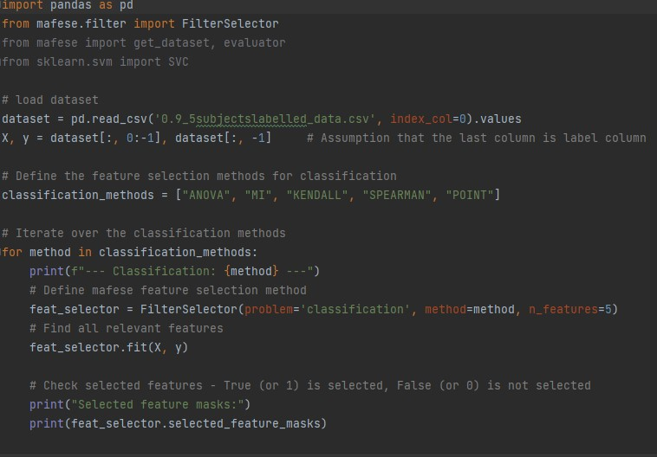
Approach 1: Exhaustive Combination
Correlation
Total: 12 combinations
Both Classifier and Regression

Slide 3
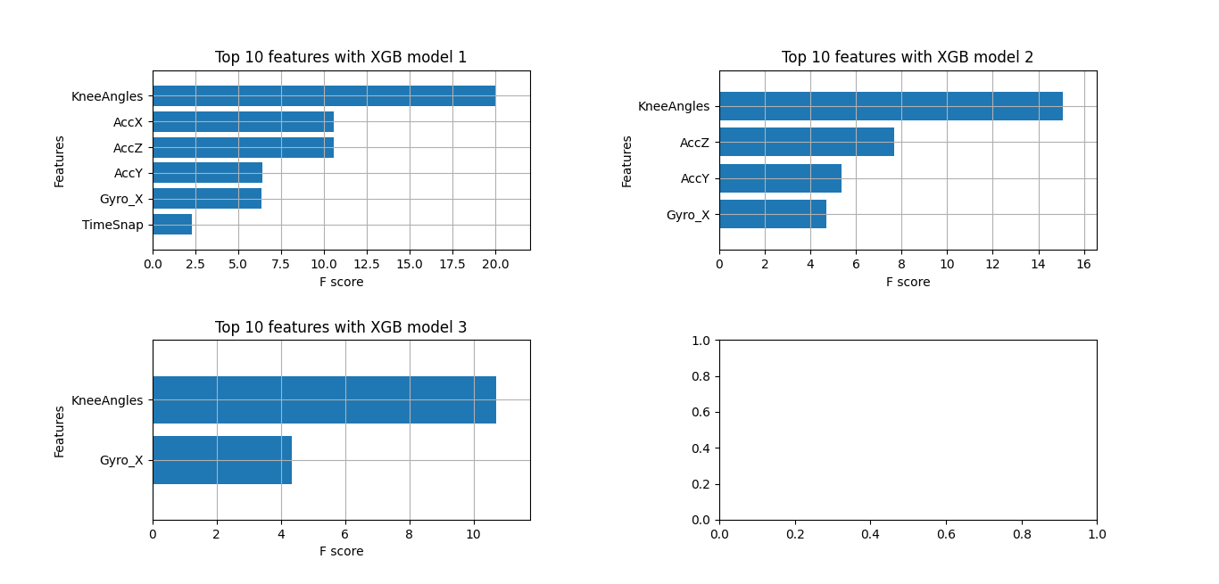
Approach 1: Exhaustive Combination
XG boost
Total: 1 combination
Classifier

Slide 4
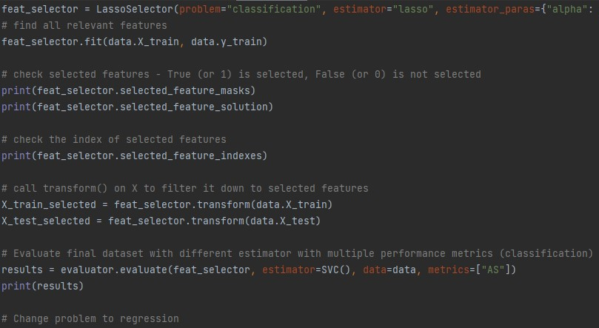
Approach 1: Manual Method use Mafese
Lasso
Total: 2 Combinations

Slide 5
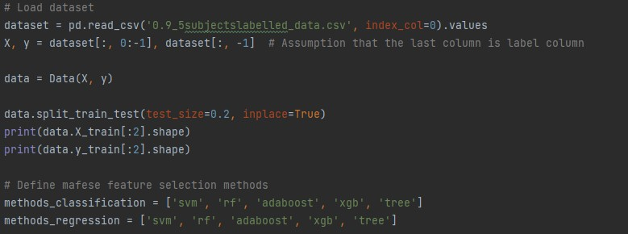
Approach 1: Manual Method use Mafese
Recursive
Total: 14 Combinations

Slide 6
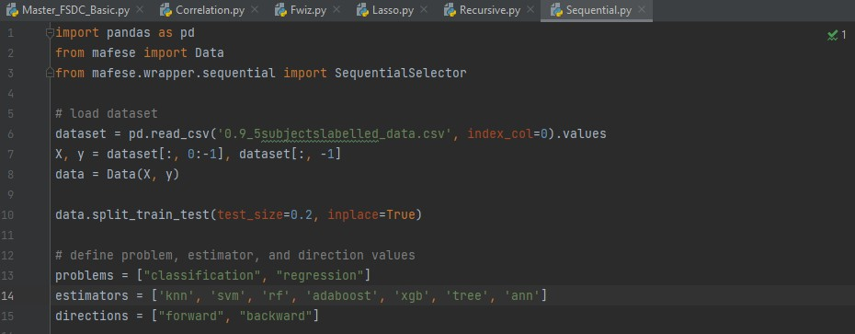
Approach 1: Manual Method use Mafese
Sequential
Total: 28 Combinations

Slide 7
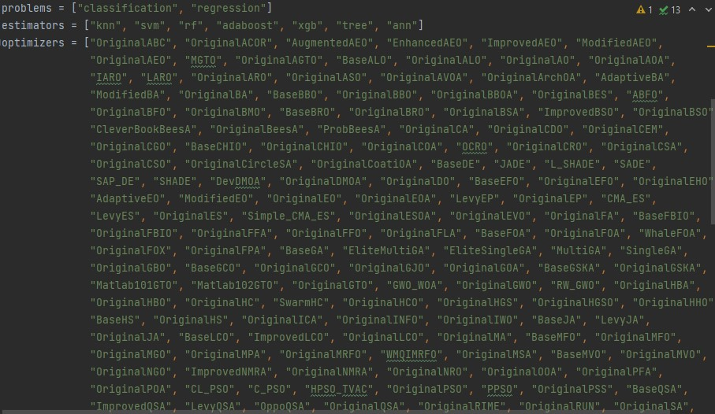
Approach 1: Manual Method use Mafese
Metaheuristic
175+ Optimizers
Total: 2520 Combinations

Slide 8
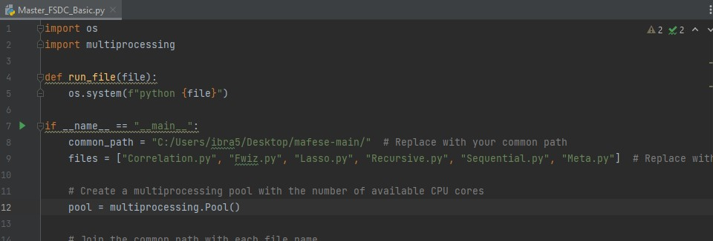
Pros and Cons
Can be done using parallel processing
Total combinations - 2577
Estimated time to run - 5 days

Slide 9
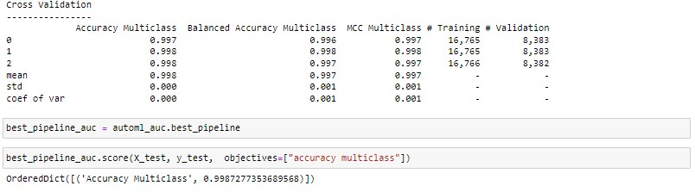
AutoML-Based Approach: Classifier

Slide 10
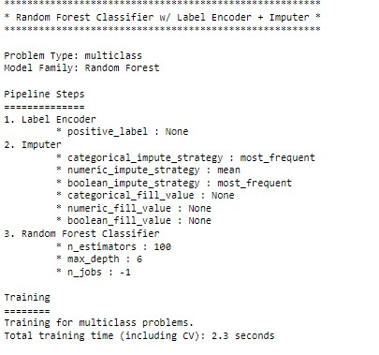
AutoML-Based Approach: Classifier

Slide 11
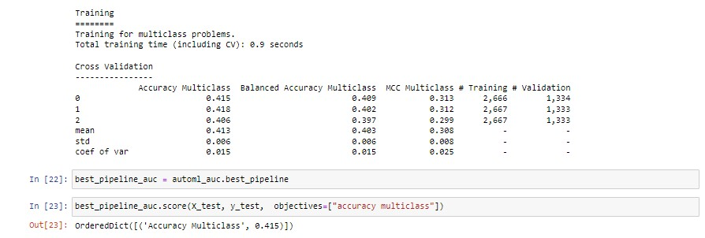
AutoML-Based Approach: Classifier + TSFRESH

Slide 12
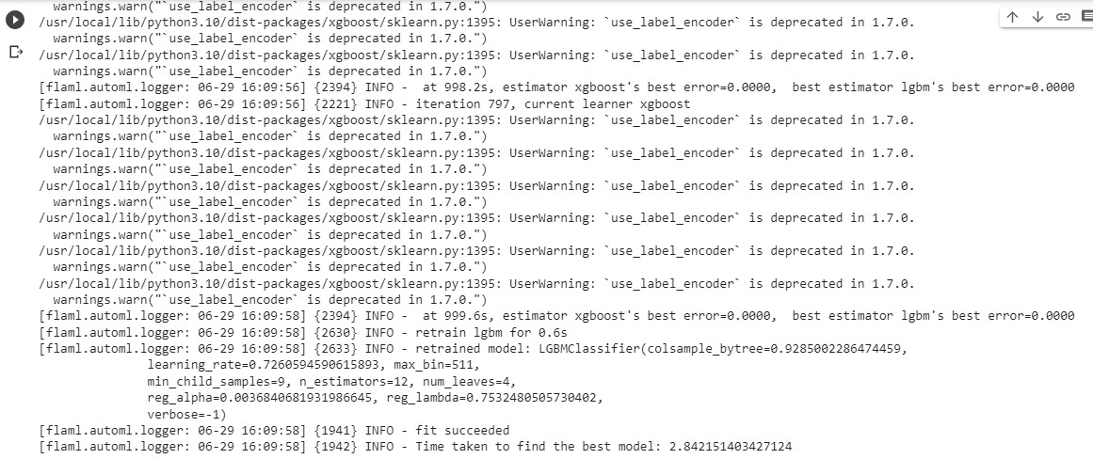
AutoML-Based Approach 2: Classifier

Slide 13
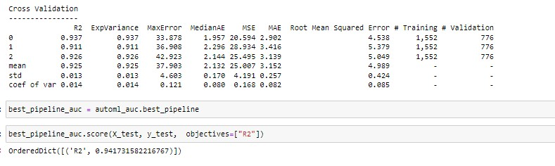
AutoML-Based Approach: Regression

Slide 14
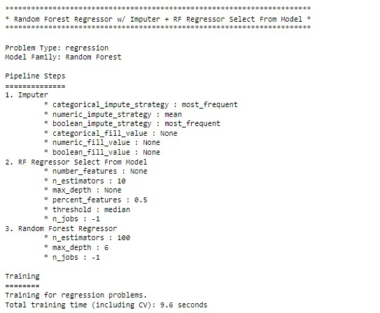
AutoML-Based Approach: Regression

Slide 15
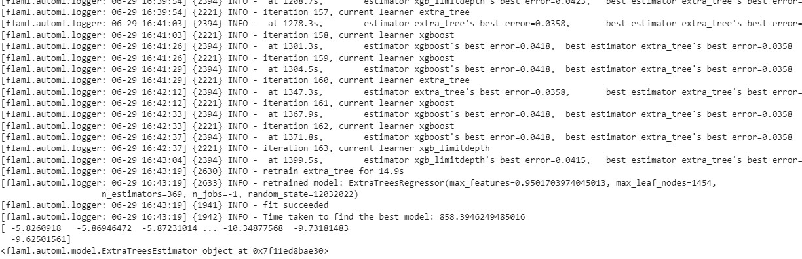
AutoML-Based Approach 2: Regression

Slide 16
Pros and Cons
Does not go through all the possible approaches
Faster
Regression does not support multiple predictors
Higher accuracy can be achieved using LSTM, 1 – 1.75% greater
Faster than Exhaustive Method
Does not use Optimizers

